Slide 1


Frameworks
SQA 215 – Automation Testing
Contents:
Java Environment Setup
Maven Environment Setup
What is Maven?
What is Framework?
What is Cucumber(Behavior Driven Development)
What is TestNG ( Data Driven Framework)
What is POM design Pattern (Page Object Model)

Slide 2
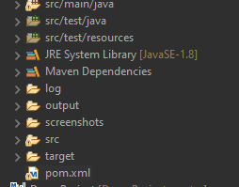
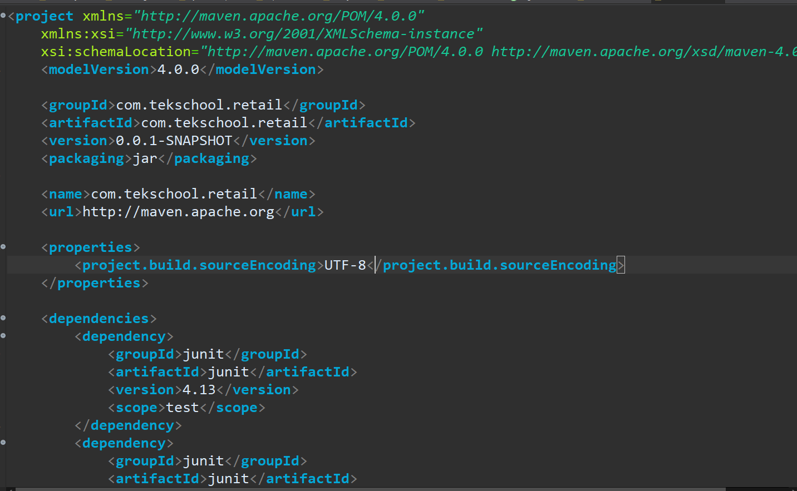
Maven
Apache Maven is a software project management and comprehension tool. Based on the concept of a project object model (POM), Maven can manage a project's build, reporting and documentation from a central piece of information. Using maven we can build and manage any Java based project
POM stands for Project Object Model
POM stands for Project Object Model. It is fundamental unit of work in Maven. It is an XML file that resides in the base directory of the project as pom.xml.
POM also contains the goals and plugins. While executing a task or goal, Maven looks for the POM in the current directory. It reads the POM, gets the needed configuration information, and then executes the goal. Some of the configuration that can be specified in the POM are following −
-project dependencies
-Plugins
-goals
-build profiles
-project version

Slide 3
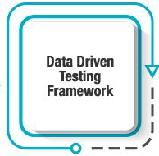
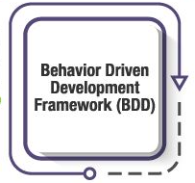
Framework
Test Automation Framework as a set of guidelines for creating and designing test cases.
It is essential to use a framework for automated testing as it specifically improves the automation testing team’s efficiency and test speed. This automation testing framework also helps to improve test accuracy, and drastically reduces the test maintenance costs and lowers risks involved
What Is the purpose of a Test Automation Framework?
Enhances efficiency during the design and development of automated test scripts by enabling the reuse of components or code
Provides a structured development methodology to ensure uniformity of design across multiple test scripts to reduce dependency on individual test-cases
Reduces dependence on teams by automatically selecting the test to execute according to test scenarios
Refines dynamically test scope according to changes in the test strategy or conditions of the system under test
Improves utilization of various resources and enables maximum returns on efforts

Slide 4
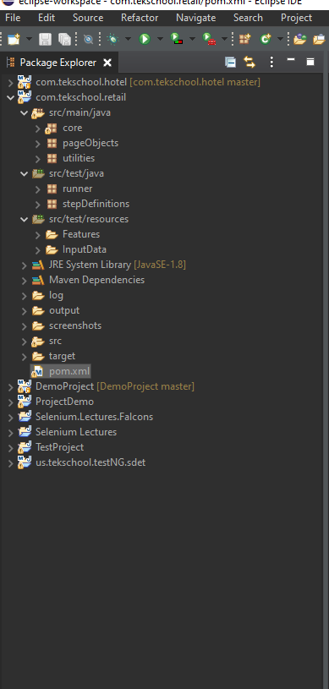
Framework
Data Driven Testing Framework:
In this testing framework, a separate file in a tabular format is used to store both the input and the expected output results. In this framework, a single driver script can execute all the test cases with multiple sets of data.
This driver script contains navigation that spreads through the program which covers both reading of data files and logging of test status information.
Behavior Driven Development Framework (BDD):
This has been derived from the TDD approach and in this method tests are more focused and are based on the system behavior. In this approach, the testers can create test cases in simple English language. This simple English language helps even the non-technical people to easily analyze and understand the tests.
There are many types of Test Automation Frameworks but for this course we just cover once are popular in market, below are some other types of frameworks:
Linear Scripting Framework:
Modular Testing Framework:
Keyword Driven Testing Framework:

Slide 5
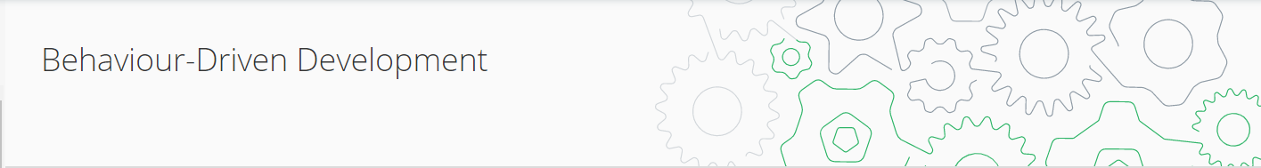

What is BDD?
BDD is a way for software teams to work that closes the gap between business people and technical people
What is Cucumber?
Cucumber is a testing tool that supports Behavior Driven Development (BDD). It offers a way to write tests that anybody can understand, regardless of their technical knowledge. In BDD, users (business analysts, product owners) first write scenarios or acceptance tests that describe the behavior of the system from the customer's perspective, for review and sign-off by the product owners before developers write their codes

Slide 6
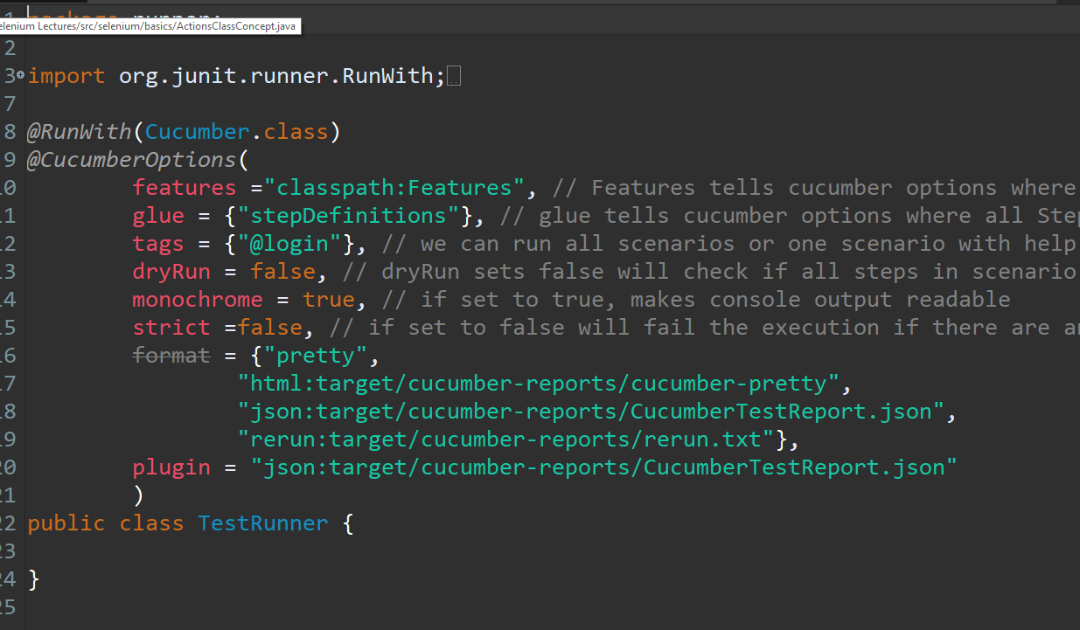
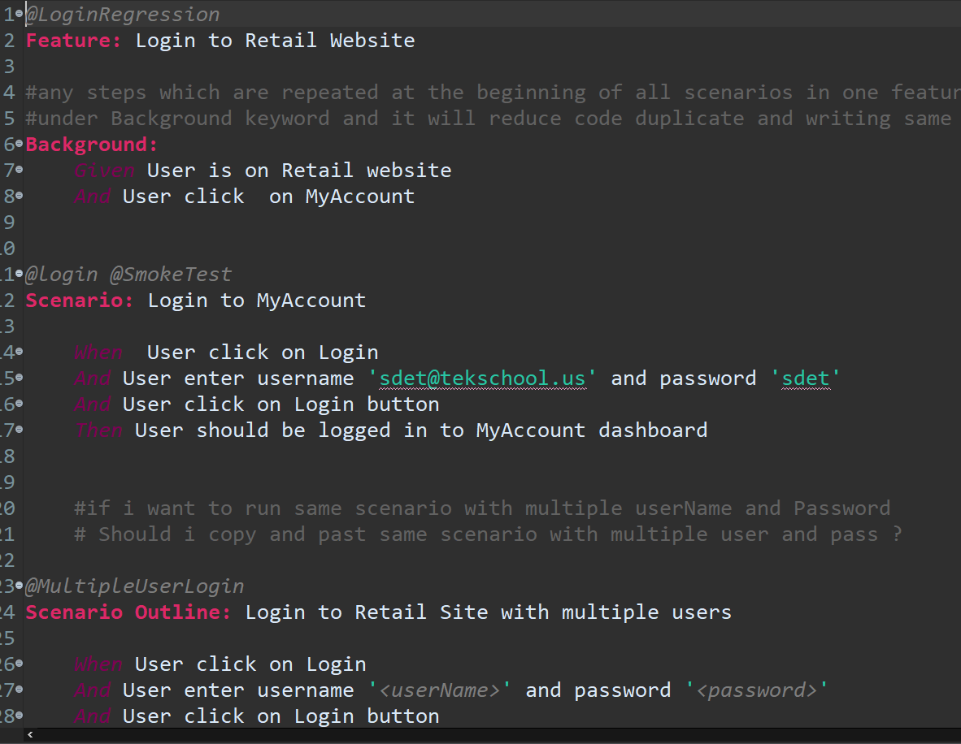
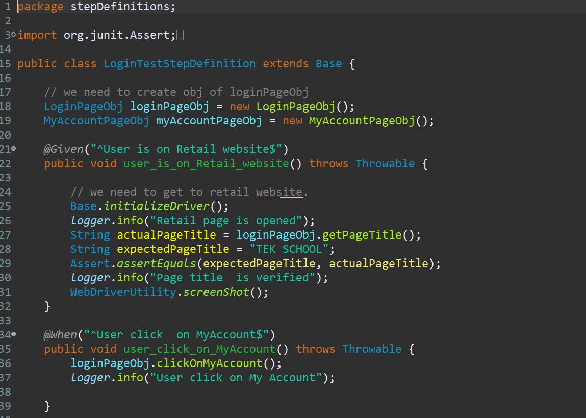
Cucumber Main Components:
Feature File
Step Definitions Class
Test Runner

Slide 7
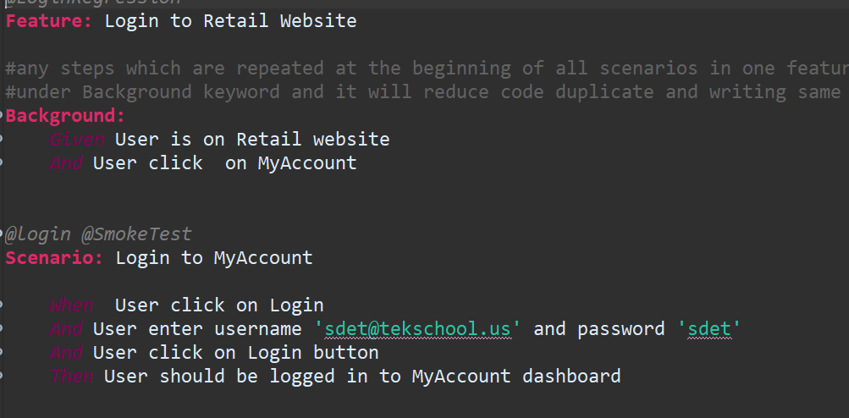
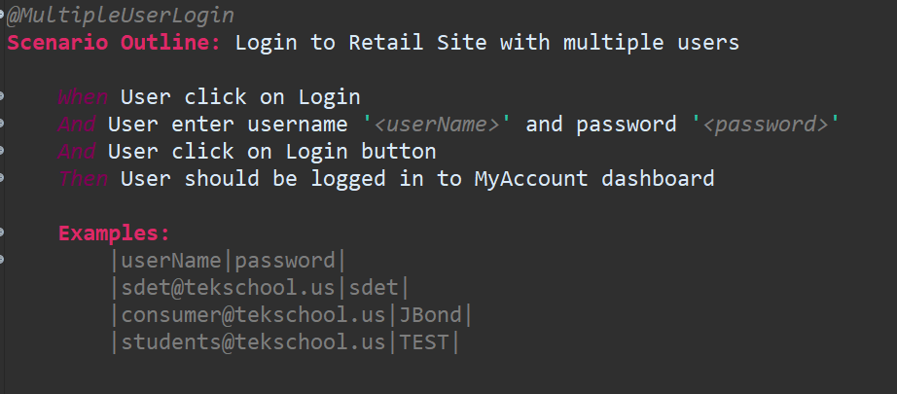
Feature File
A Feature File is an entry point to the Cucumber tests. This is a file where you will describe your tests in Descriptive language (Like English).
It is an essential part of Cucumber, as it serves as an automation test script as well as live documents. A feature file can contain a scenario or can contain many scenarios in a single feature file but it usually contains a list of scenarios.
Feature File
Scenario
Scenario Outline
Examples
Background

Slide 8
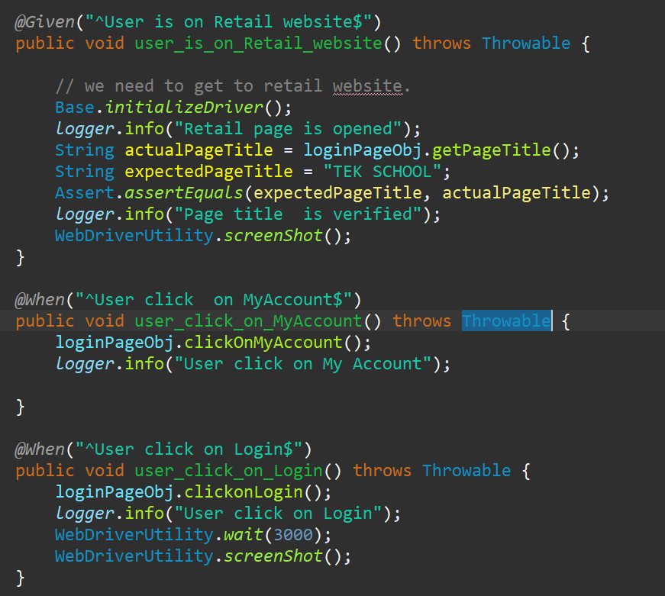
Step Definitions Class
A Step Definition is a small piece of code with a pattern attached to it or in other words a Step Definition is a java method in a class with an annotation above it. An annotation followed by the pattern is used to link the Step Definition to all the matching Steps, and the code is what Cucumber will execute when it sees a Gherkin Step. Cucumber finds the Step Definition file with the help of the Glue code in Cucumber Options.
@Given("^User is on Retail website$")
public void user_is_on_Retail_website() throws Throwable {
}
@When("^User click on MyAccount$")
public void user_click_on_MyAccount() throws Throwable {
}
@Then("^User should be logged in to MyAccount dashboard$")
public void user_should_be_logged_in_to_MyAccount_dashboard() throws Throwable {
}

Slide 9
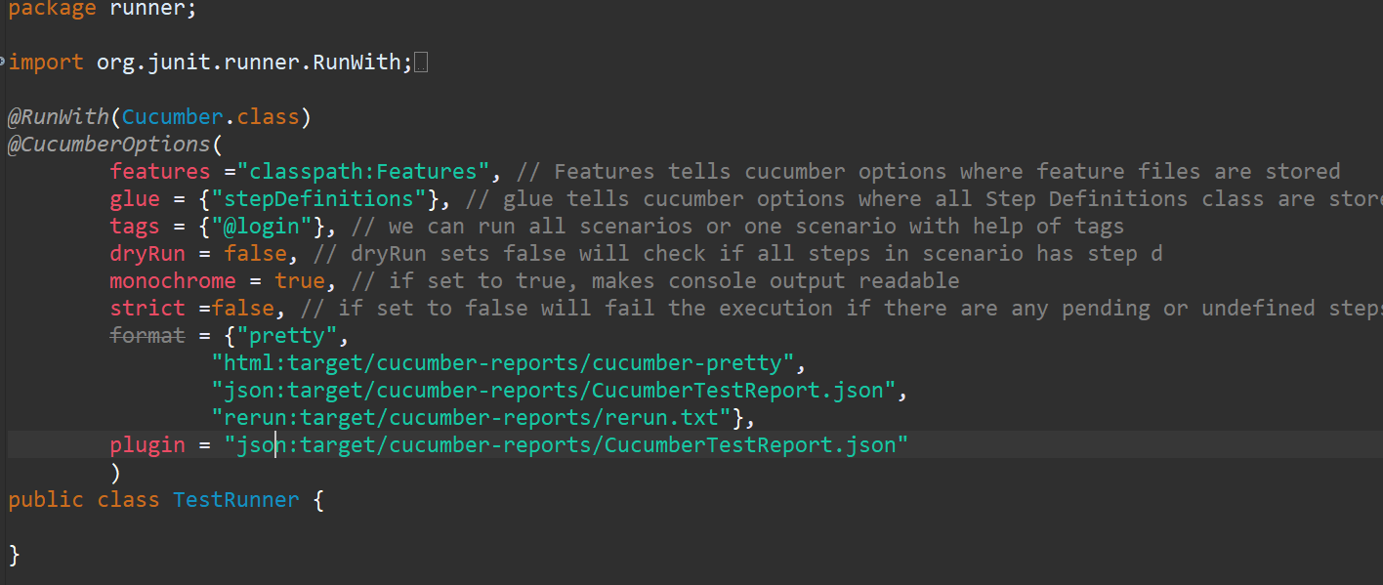
Test Runner Class
Cucumber uses Junit framework to run. As Cucumber uses Junit we need to have a Test Runner class. This class will use the Junit annotation @RunWith(), which tells JUnit what is the test runner class. It more like a starting point for Junit to start executing your tests.
@CucumberOptions
Dry Run
Monochrome
Features
Glue
Format

Slide 10

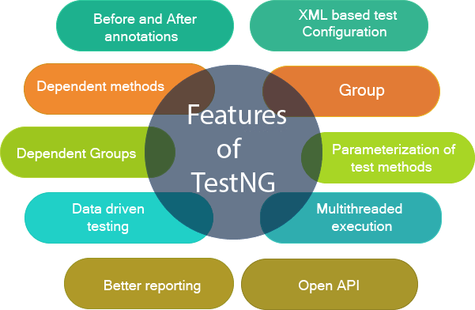
TestNG Framework
It is an open-source automated testing framework; where NG of TestNG means Next Generation. TestNG is similar to JUnit but it is much more powerful than JUnit but still, it’s inspired by JUnit. It is designed to be better than JUnit, especially when testing integrated classes.
TestNG eliminates most of the limitations of the older framework and gives the developer the ability to write more flexible and powerful tests with help of easy annotations, grouping, sequencing & parametrizing.

Slide 11
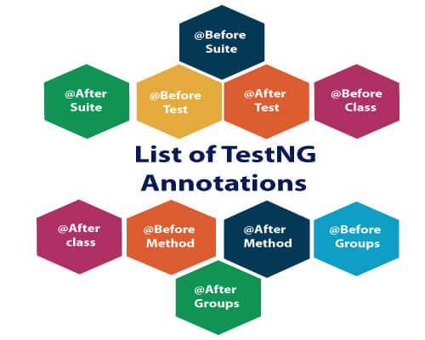
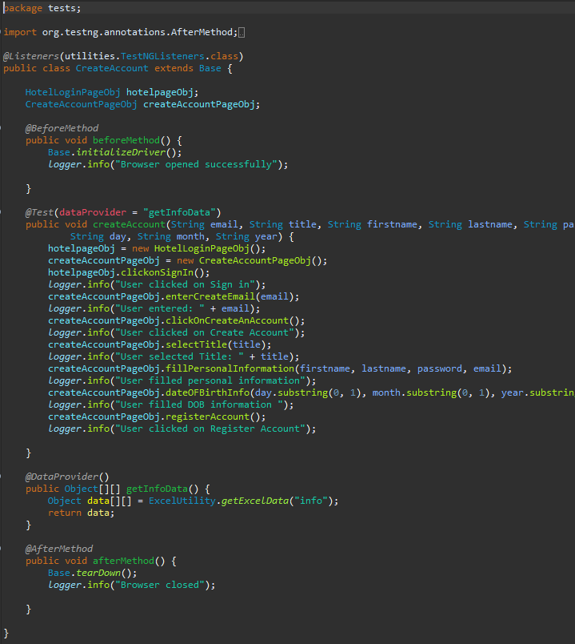
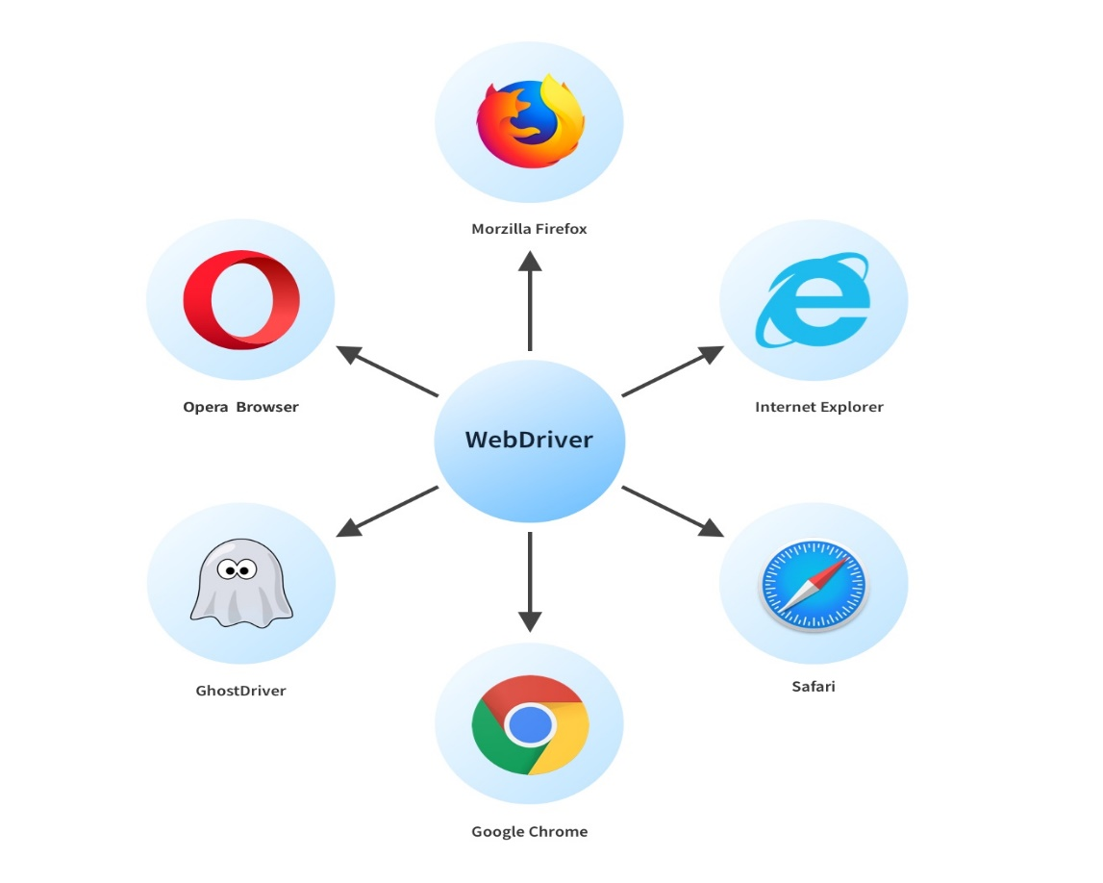
TestNG Framework

Slide 12
TestNG Outline
TestNG Test
TestNG Test Suite
TestNG Annotations
TestNG Groups
TestNG Dependent Tests
TestNG Parameters
TestNG DataProviders
TestNG Test Priority
TestNG Asserts
TestNG Cross Browser Testing
TestNG Data Provider with Excel
TestNG Parallel Execution
TestNG Listeners

Slide 13
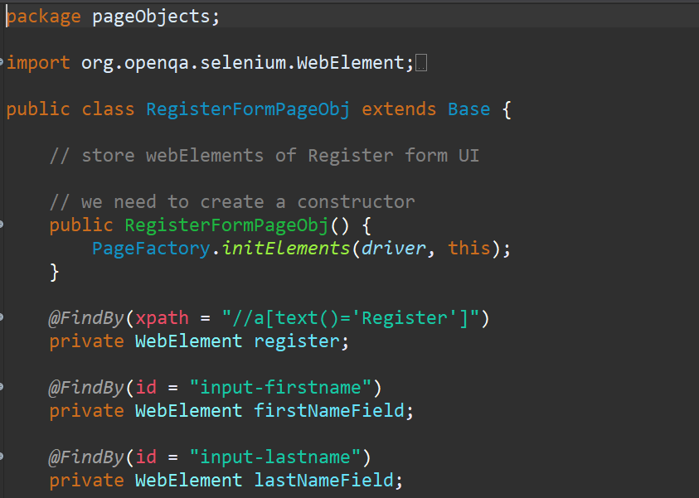
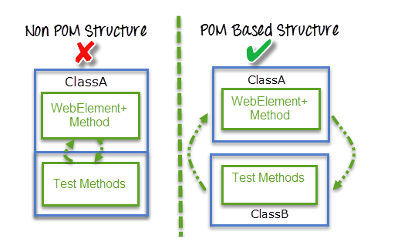
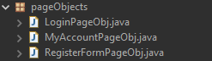
POM design Pattern (Page Object Model)
Page Object Model, also known as POM is a design pattern in Selenium that creates an object repository for storing all web elements. It is useful in reducing code duplication and improves test case maintenance. In Page Object Model, consider each web page of an application as a class file
Page Factory in Selenium is an inbuilt Page Object Model framework concept for Selenium WebDriver but it is very optimized. It is used for initialization of Page objects or to instantiate the Page object itself. It is also used to initialize Page class elements without using "FindElement/s."
Here as well, we follow the concept of separation of Page Object Repository and Test Methods. Additionally, with the help of class PageFactory in Selenium, we use annotations @FindBy to find WebElement. We use initElements method to initialize web elements

